Slide 1

WordPress Automation App
Anna Javashvili
Data Analytics, March 2024 Cohort, Portugal
App that Automates Online Publishing Process on WordPress Websites

Slide 2
Topics Covered:
Motivation Behind the App
Why this app was created
Introduction to WordPress
Overview and functionality
Product Presentation & Demo
Showcasing the actual product
Limitations
Current constraints
Future Plans
Improvements and possibilities

Slide 3
What’s the Idea Behind this Application
Many articles daily/monthly, around180-200 per month.
Involves repetitive tasks, time consuming, prone to errors
Idea to automate repetitive parts of the job

Slide 4


Process for Publishing Content on WP:
Receive Content
A Google Doc with text and images from the article author
A folder with high-quality images from the graphic designer
Content Upload
Upload text to the WordPress website - Format the content appropriately
Upload high-quality images provided by the graphic designer - Add captions and alt texts to the images

Slide 5
WordPress – Content Management System
WordPress is a tool that helps you create and manage websites without needing to know how to code.
Used to build blogs, online magazines, stores and more.

Slide 6
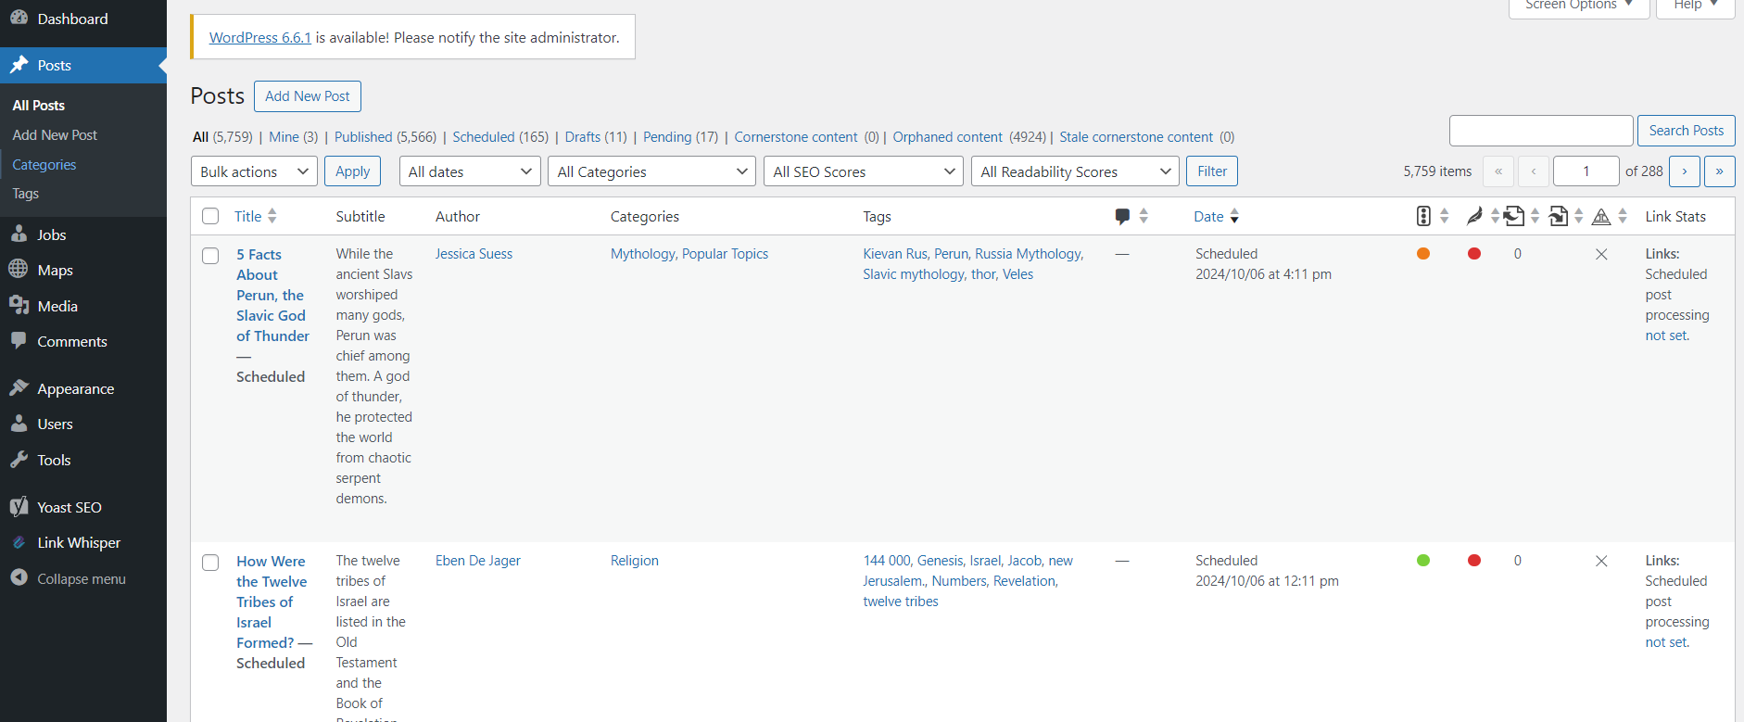
WordPress Admin – Posts

Slide 7
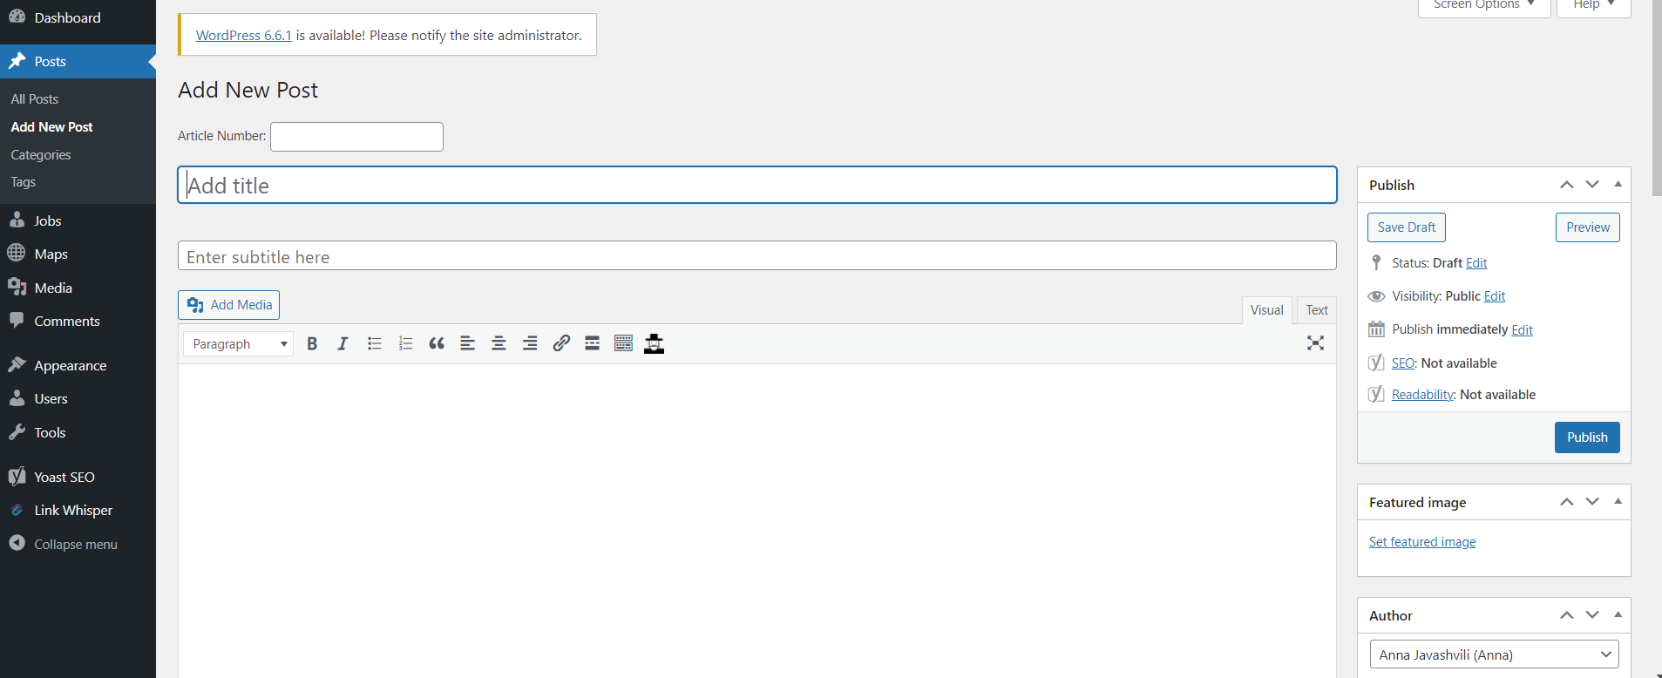
WordPress – Adding Posts

Slide 8
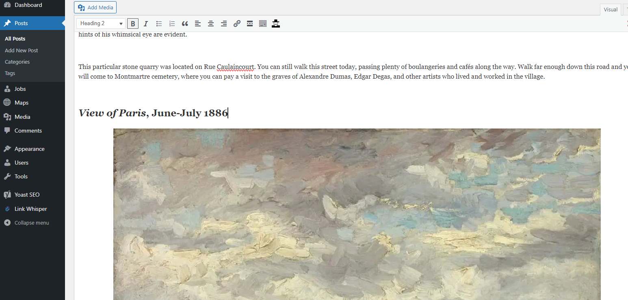
Formatting Text
Titles, Bold, H2

Slide 9
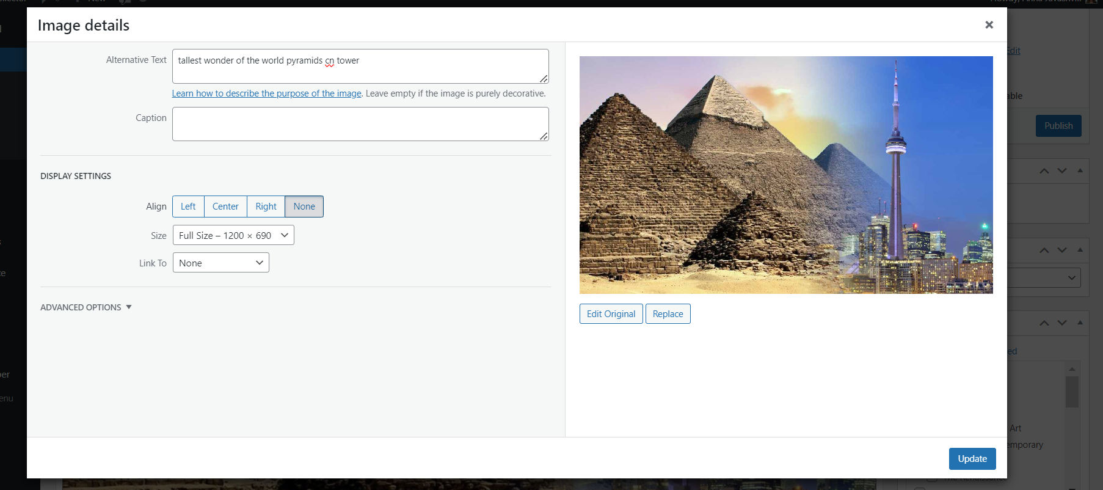
WordPress – Adding Images
Alt Text
Caption

Slide 10
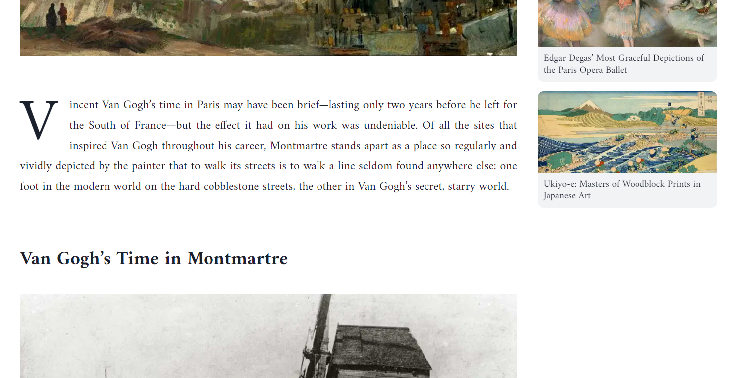
Final Result - Fully Formatted Article on the Website

Slide 11
Challenges
Articles can be long with multiple Headings and Many images
Time Consuming
Error-Prone Steps: Manual Text Upload: Risk of formatting errors (titles, links, etc.).
Image Handling: Potential for incorrect captions or alt texts.

Slide 12
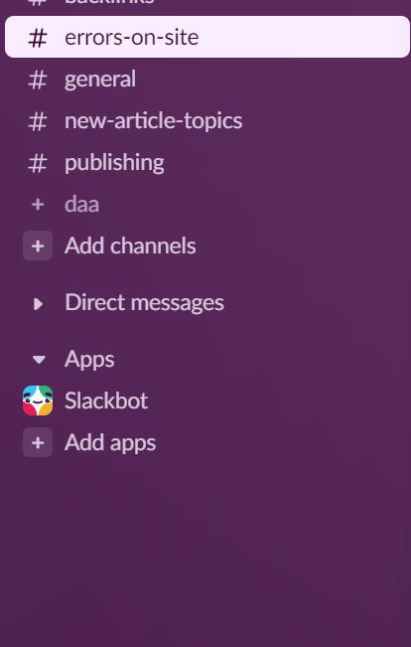
Special Channel on Slack
This is a special channel on Slack communication platform where we discuss Errors on one of the Websites

Slide 13

WordPress Flow Demo
The App runs on Windows, so I can just start it as any program
I will use my own WordPress Blog for the purposes of Demo
I will upload a simple article using this app
I will walkthrough through the whole process

Slide 14

The App
Around 800 Lines of Python Code
The publishing process made faster
Reducing Errors
Runs on Windows without needing Python Interpreter

Slide 15
Limitations
Needs adjustments for different WordPress Websites
Needs adjustments for different scenarios

Slide 16
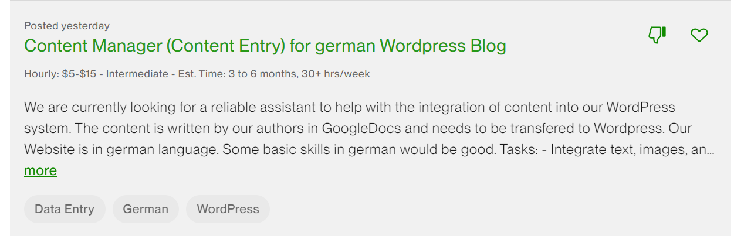
Future Possibilities & Improvments
Work on the Limitations
Improve User Experience: Make the app more intuitive and user-friendly.
Think about Possibilities for Distribution: Partnering with Blogs and Websites

Slide 17
Thank You Obrigada მადლობა

